Slide 1
The Voter Education Project, Inc.
Archives Research Center
Atlanta University Center Robert W. Woodruff Library
October 23, 2012

Slide 2
About Woodruff Library
Unique Institution
Academic Hub in the Atlanta University Center
Serves 4 Institutions of Higher Learning
  Clark Atlanta University
  Interdenominational Theological Center
  Morehouse College
  Spelman College

Slide 3
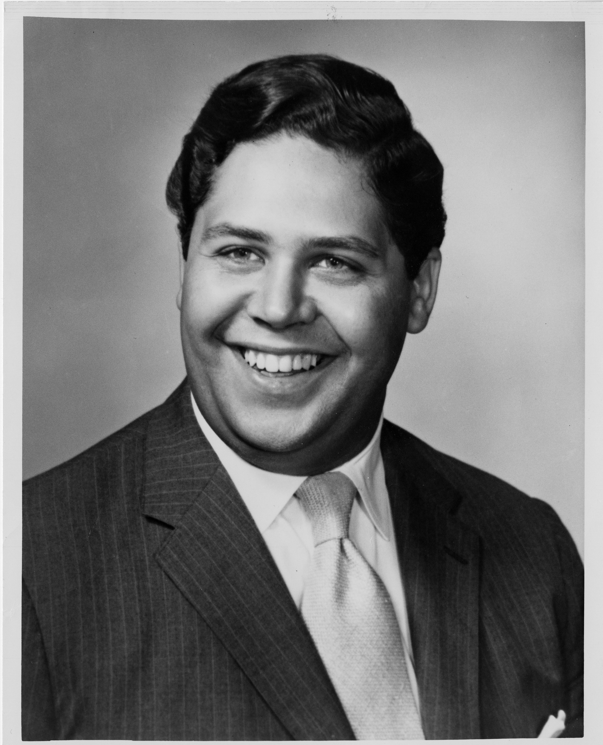
Archives Research Center
Rare book collection
Archival collections
  AUC institutions, including departments, student groups, faculty and alumni
  African American culture and history in Atlanta and the South
  Civil Rights Movement and Race Relations

Slide 4
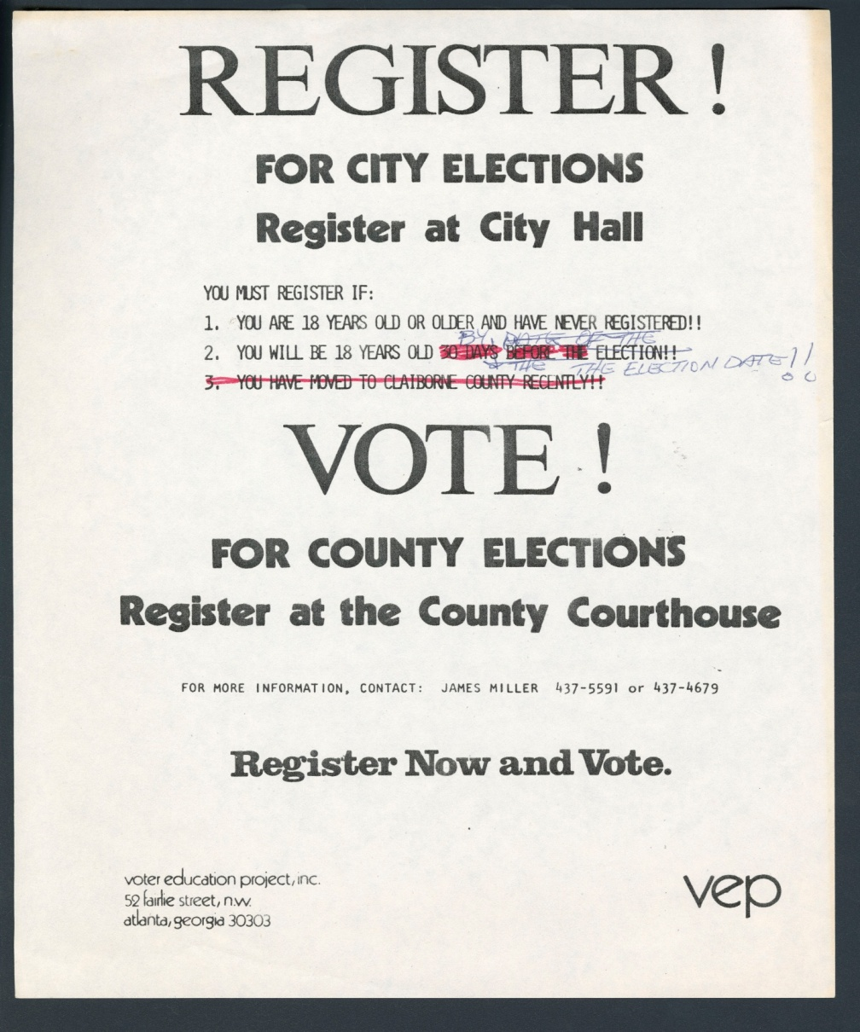
VEP History
Founded in 1962 as a special project of the Southern Regional Council
Goals
  Direct grants for voter registration drives
  Promote citizenship education through workshops, conferences, and printed/audio-visual material
  Assist elected officials of color through Centers for Elected Officials
  Investigate causes and remedies of low political participation by African-Americans though published research and statistics

Slide 5
Voting Rights Success
In 1962, less than 500,000 African-Americans were registered to vote in the South…but by 1971, there were over 3 million!
By 1982, over 5 million voters had been registered with VEP assistance
The number of African-American elected officials increased from 72 in 1965 to over 5000 in 1988
VEP worked directly on the successful extension of the Voting Rights Act of 1965

Slide 6
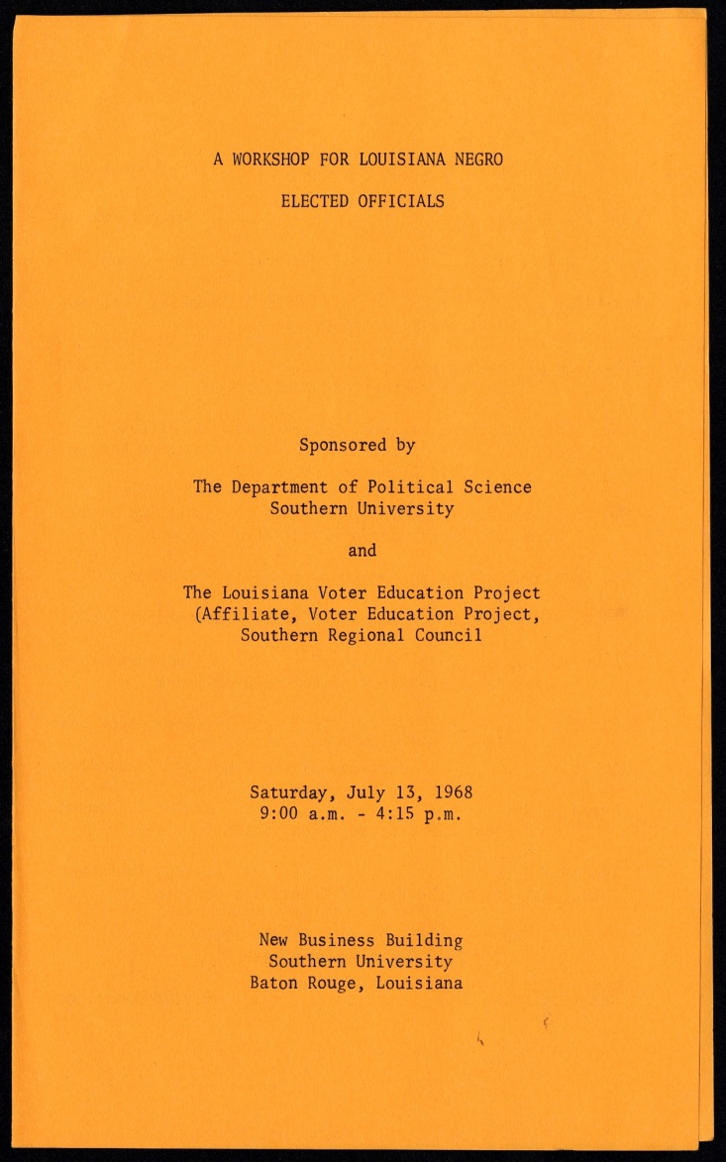

Slide 7
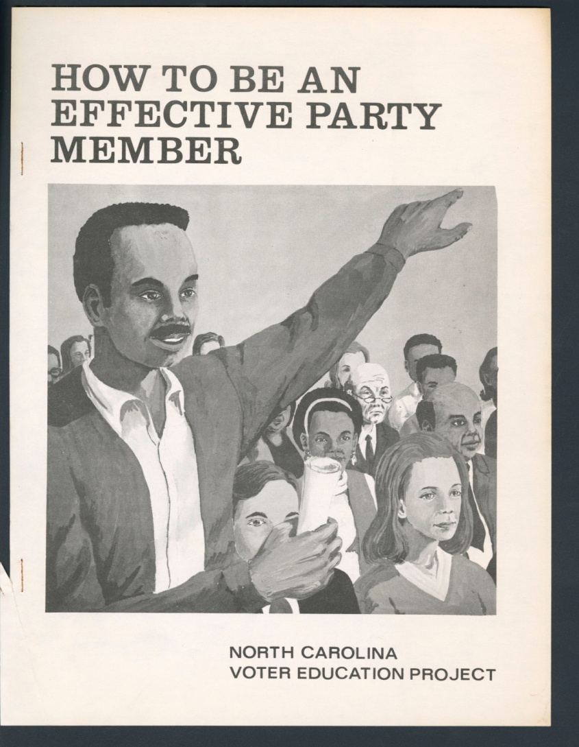
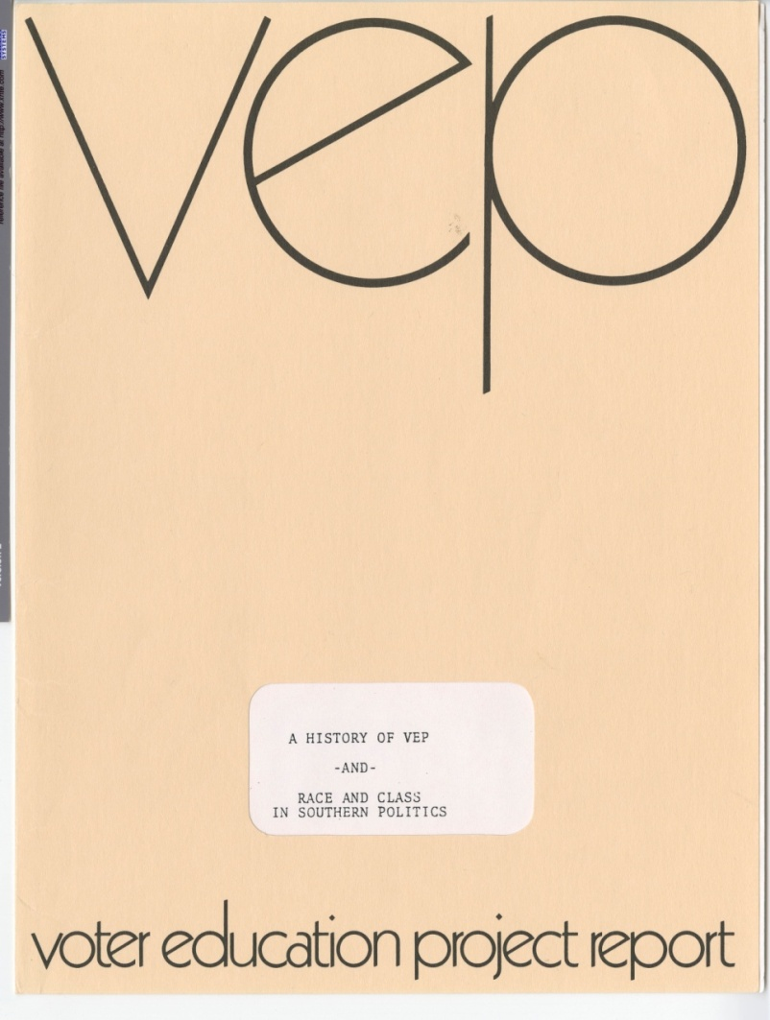

Slide 8
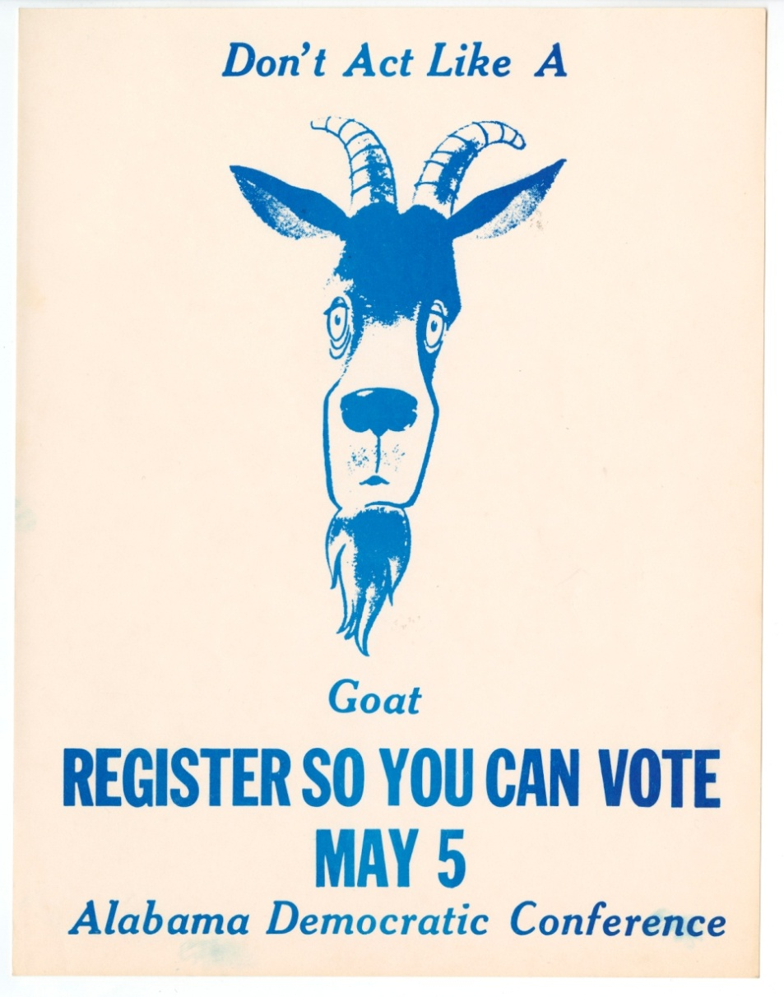
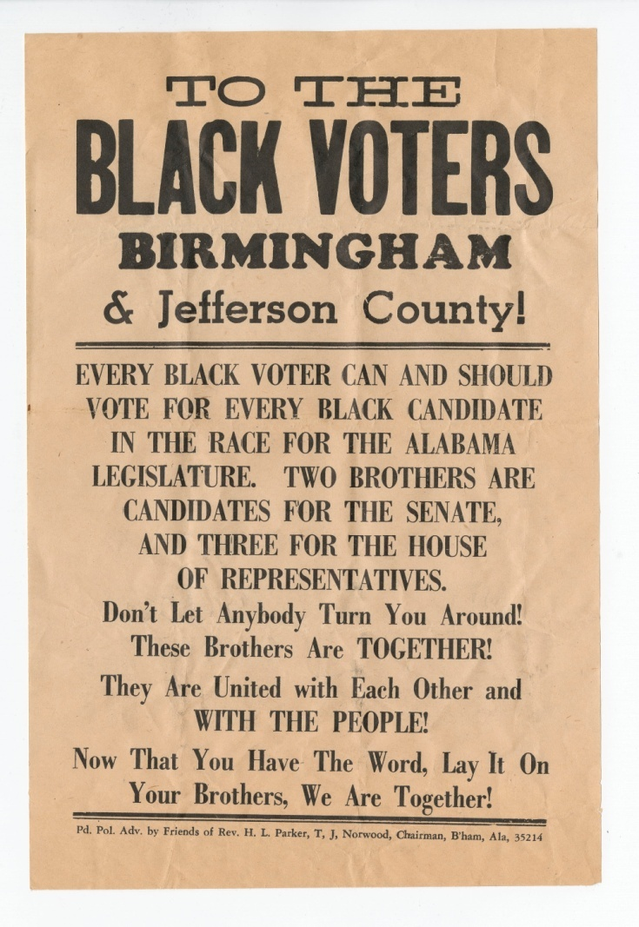

Slide 9
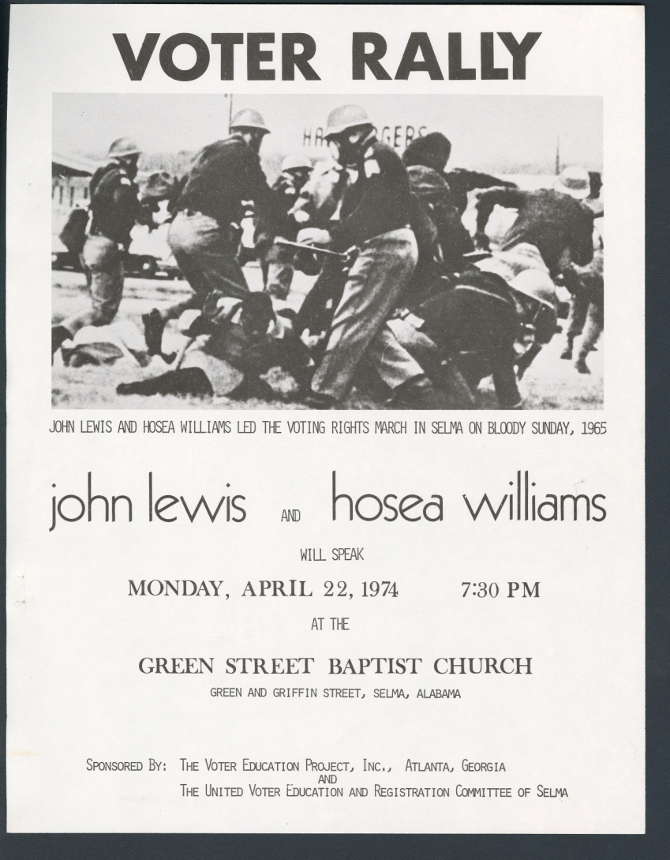
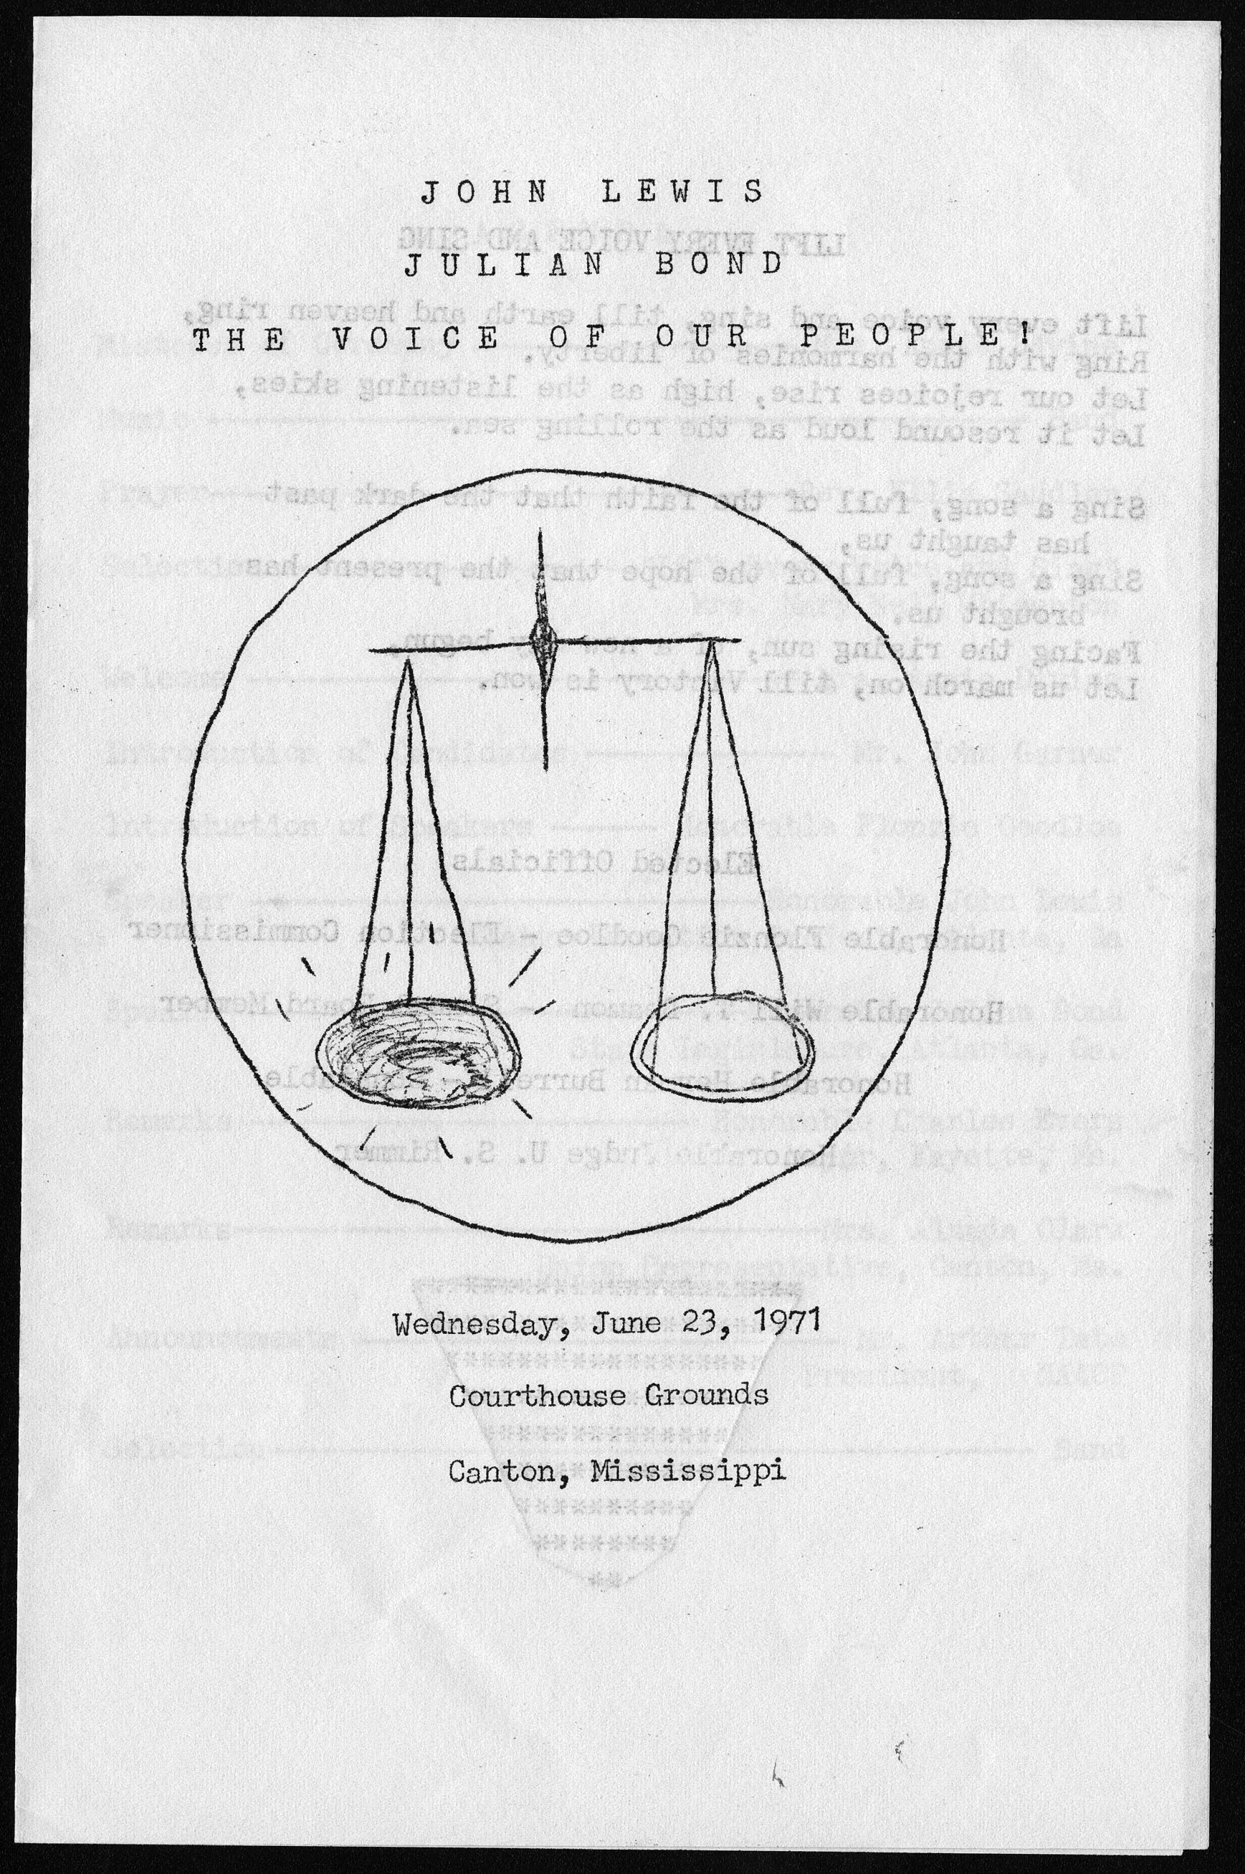

Slide 10
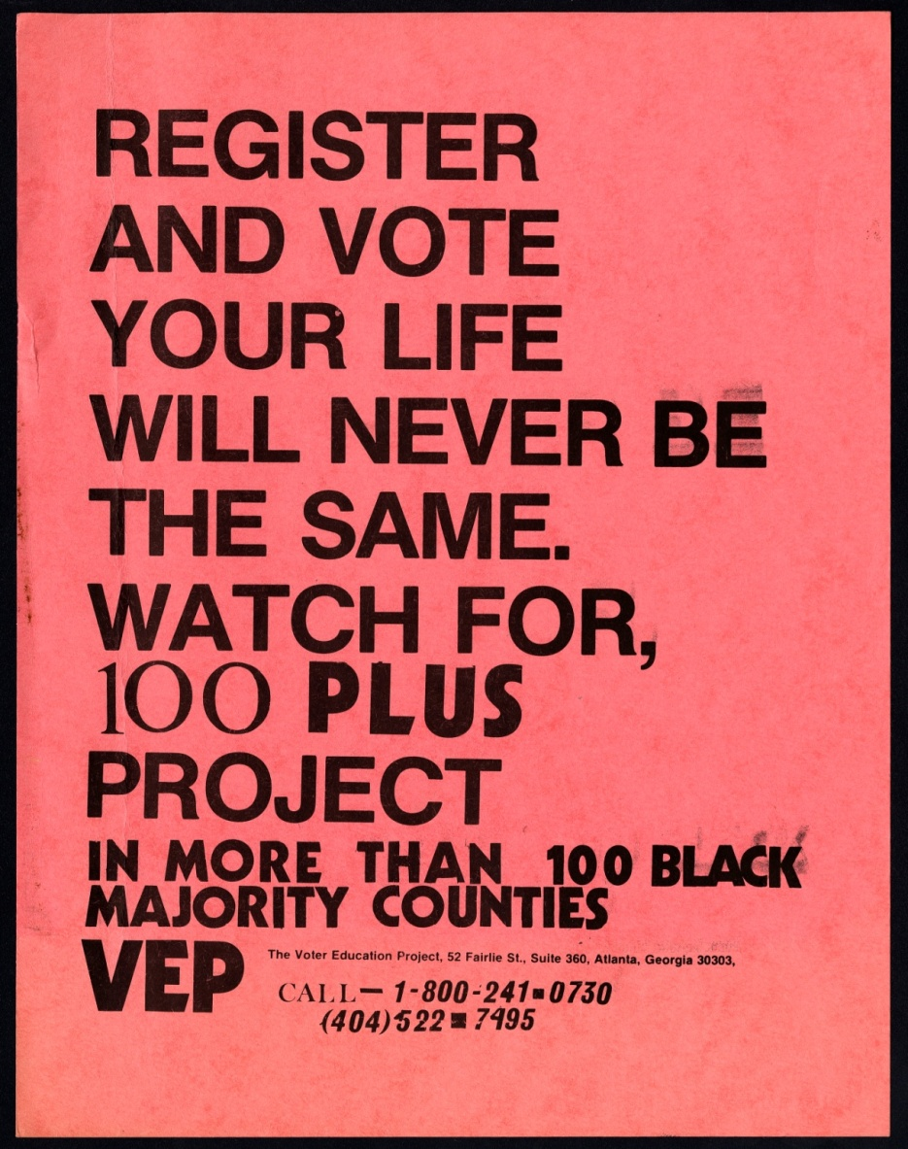
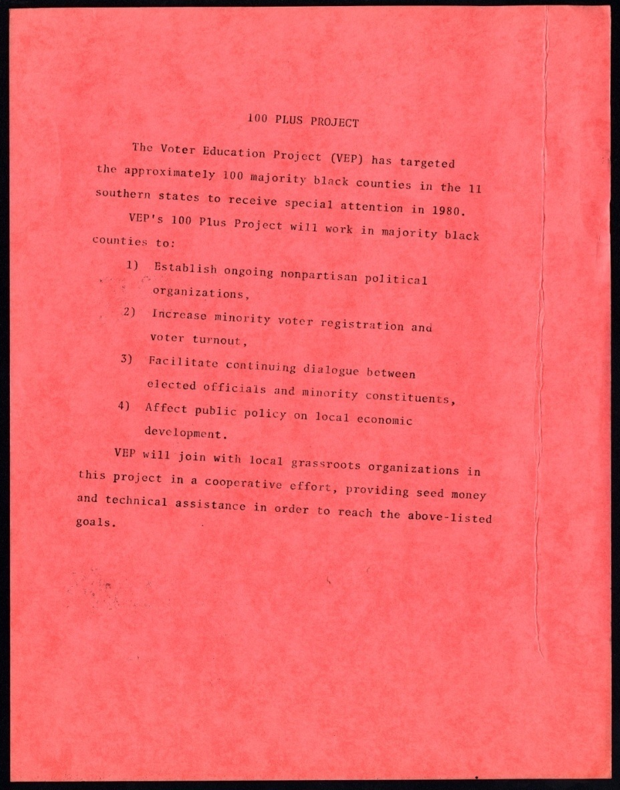

Slide 11
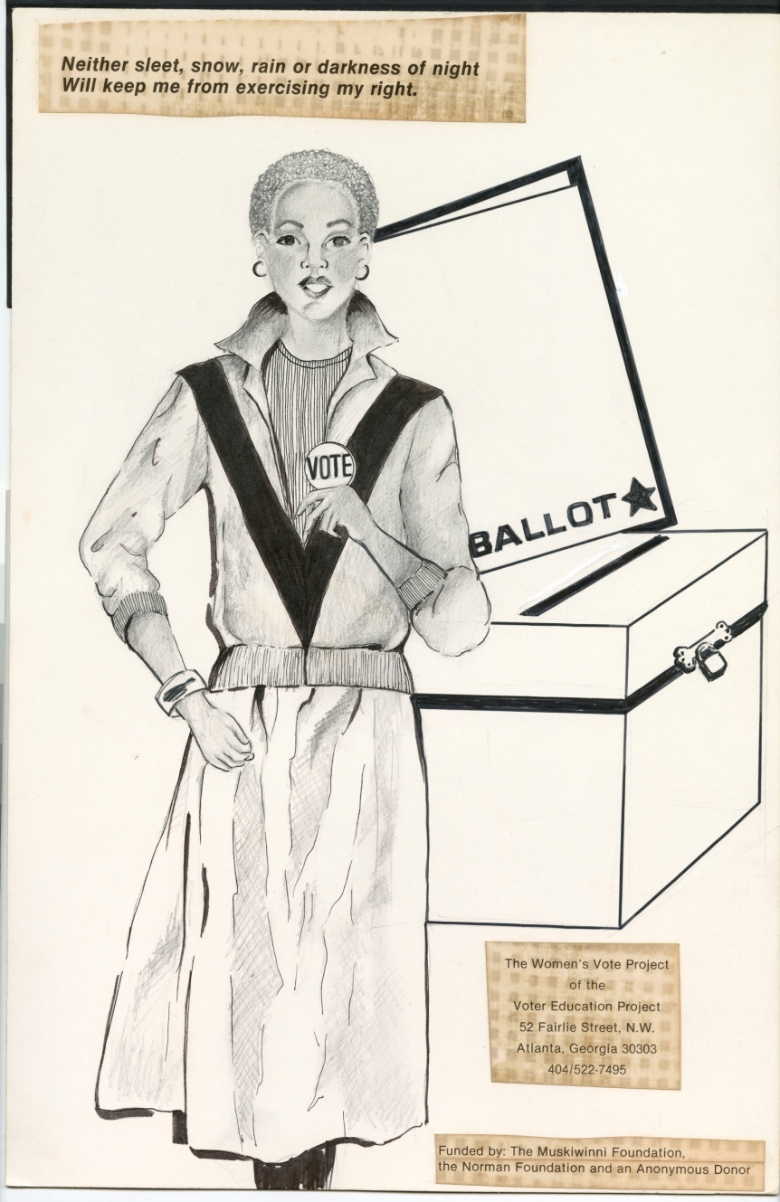
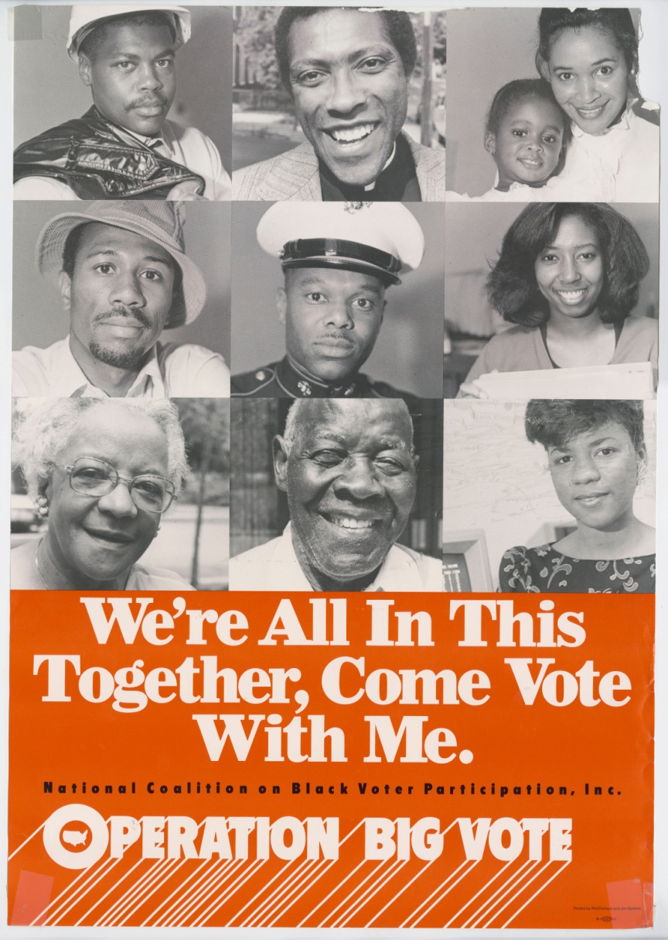

Slide 12
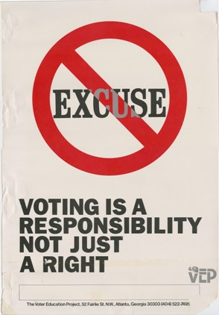
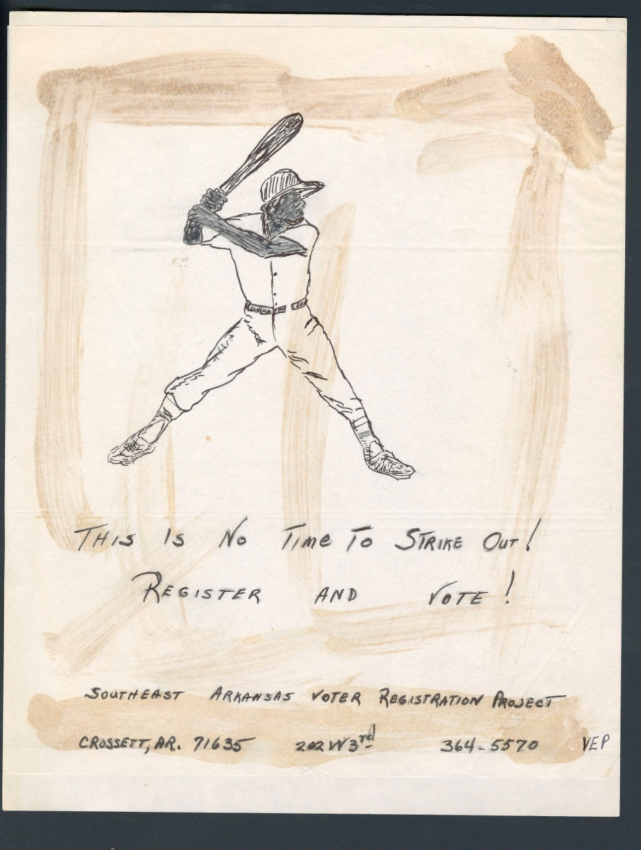

Slide 14
Dekalb County Resources
Dekalb County Voter Registration, http://web.co.dekalb.ga.us/Voter/default.html
My Voter Page (Secretary of State), https://mvp.sos.state.ga.us/Login.aspx
League of Women Voters (non-partisan) candidate research, http://lwvdk.org/elections
Project Vote Smart (non-partisan) candidate research, http://votesmart.org/election/2011/S/GA#.UIbgYm_R68A

Slide 15

Thank You!
Archives Research Center
archives@auctr.edu
www.auctr.edu

